Slide 1
SOFTWARE PROJECT MANAGEMENT THE MANAGER’S VIEW
Presented by:
C.Krishna Manmitha(Njitid:31406694)
Krishna Chaitanya(Njitid:31405389)
Venkat Krishna Rohith Pabbathi(Njitid:31390939)

Slide 2
Overview:
In the field of Software Development, it is imperative to ace technical abilities as well as managerial abilities due to the increasing pressure of delivery of quality projects within time and budget. The presentation will show the crucial ideas of present day Management techniques, how these ideas can be connected to software development projects and will give you a big picture of current Software project management practices which were honed throughout the years from an assortment of large complex projects.

Slide 3
INTRODUCTION
Project Management and its inception
Organized approach
Dealing with the complexities involved
Provides powerful methods and tools
Software development projects runs in a dynamic environment.

Slide 4
Common Software Related Problems are:
Intangibility
Complexity
Volatility of requirements
My View:
Overestimated savings from reusable components, new tools and methods

Slide 5
Management Related Difficulties:
Poorly defined goals and specifications
Lack of project plan
Unrealistic deadlines and budgets
My Views:
Unproductive work environment
Lack of stake holder interest

Slide 6
PROJECT MANAGEMENT
THE NATURE OF PROJECTS:
Common Characteristics Of Projects:
It has specific objectives.
It must be completed within a specific time period.
Projects must be completed within a given budget.
Projects are carried out by teams.
Projects are unique.
My views:
Project is always developed in steps and continuously increasing.
Projects involves unfamiliarity
Project is the process of working to achieve a goal.

Slide 7
Key Dimensions Of Project Management:
Fundamental objective of project management:
Time
Cost
Performance
Recently added fourth constraint:
Client Relations
My View:
Performance to be replaced by Scope
Scope further refined into Quality and Performance
Importance of two factors in Software project management:
Visibility
Commitment

Slide 8
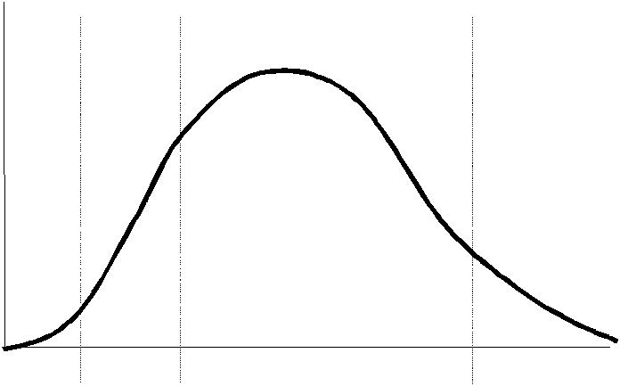
Conceptual | Planning | Execution | Termination
phase | phase | phase | phase
Resources
Time
Project Resource Utilization Curve

Slide 9
PROJECT ORGANIZATION
Selecting the project Manager:
Responsibilities of Project Manager:
Reporting to senior management
Communication with users
Planning and scheduling
Coordinating project activities
Budget, schedule, risk, and quality control
People management
Delivering results
My View:
Monitoring and reporting progress including documentation

Slide 10
Skills Required For Effective Project Manager:
Communication
Organization
Team-building
Leadership
Negotiation
Goal orientation
Ability to work under pressure
Technical competence
My Reaction:
Risk Management

Slide 11
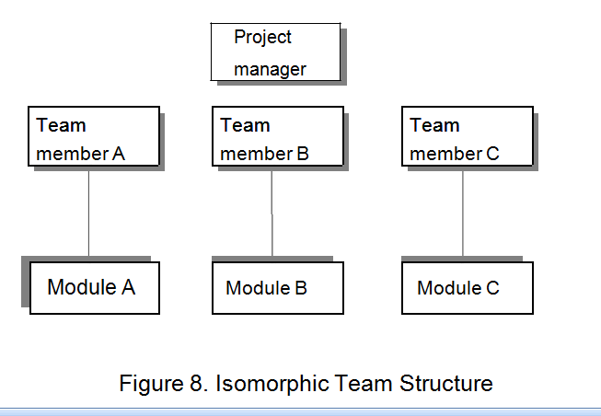
Structuring the team:
Team structures used for software development project are:
Isomorphic Team:

Slide 12
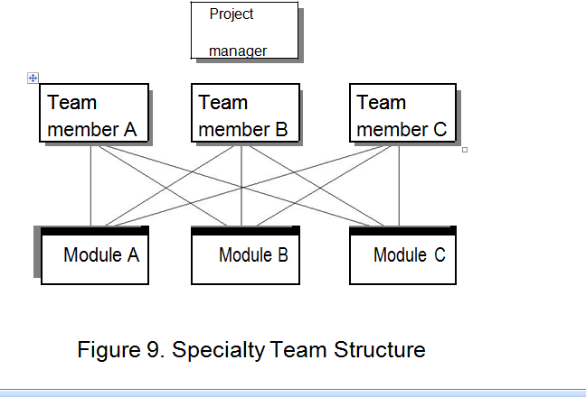
Specialty Team:

Slide 13
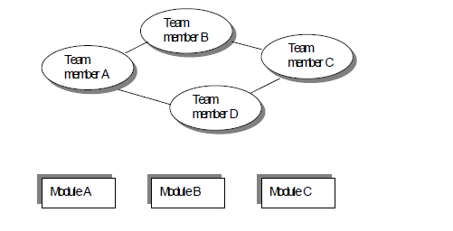
Egoless Team or Democratic Team:

Slide 14
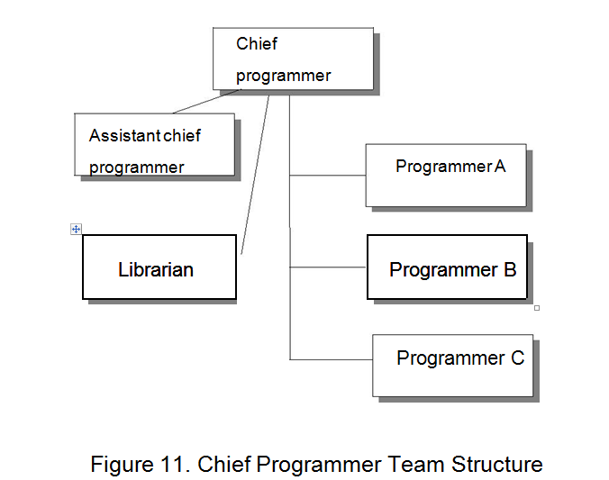
Chief Programmer Team:

Slide 15
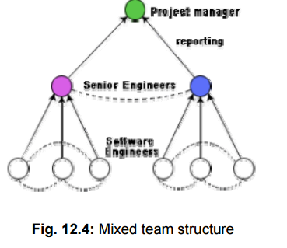
My view:
Mixed Control Team:

